Slide 1
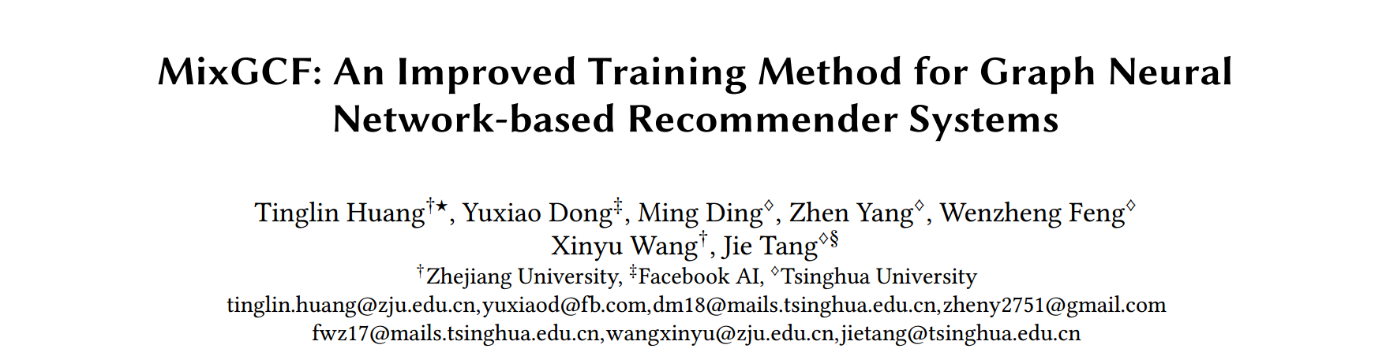

Slide 2
Motivation
The negative samples paly a decisive role in the performance of (GNN-based) recommendation models. However, existing works (e.g., PinSage, MCNS) only focus on improving negative sampling in the discrete graph space, ignoring GNN’s unique neighborhood aggregation process in the embedding space.
MixGCF synthesizes negative samples rather than directly sampling negatives from the data for improving GNN-based recommender systems.

Slide 3
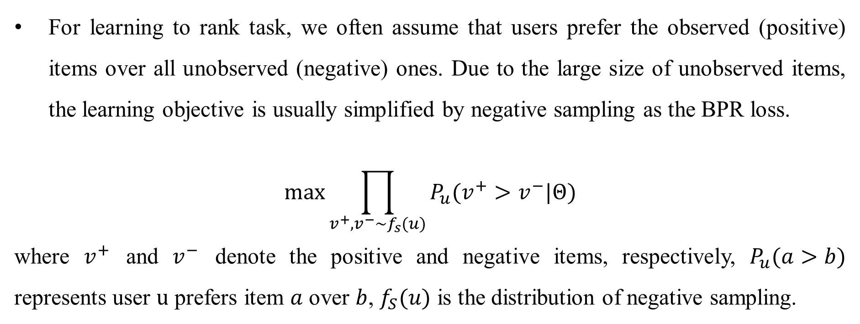
Optimization with Negative Sampling
For learning to rank task, we often assume that users prefer the observed (positive) items over all unobserved (negative) ones. Due to the large size of unobserved items, the learning objective is usually simplified by negative sampling as the BPR loss.
$$\max{\prod_{v^{+},v^{−}\sim f_{s}(u)}{P_{u}(v^{+}>v^{−}|Θ)}}$$
where $v^{+}$ and $v^{−}$ denote the positive and negative items, respectively, $P_{u}(a>b)$ represents user $u$ prefers item $a$ over $b$, $f_{S}(u)$ is the distribution of negative sampling.

Slide 4
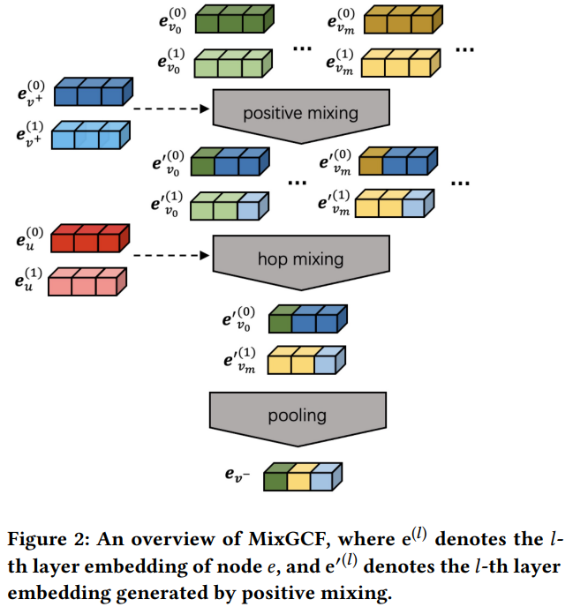
An overview of MixGCF

Slide 5
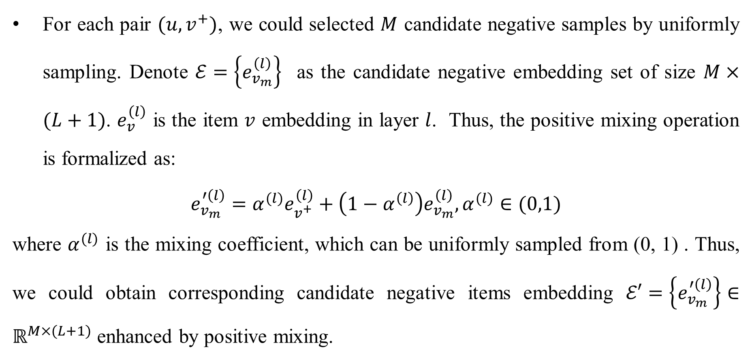
Positive Mixing
For each pair $(u, v^{+})$, we could selected $M$ candidate negative samples by uniformly sampling. Denote $ℰ=\left\{e_{v_{m}}^{\left(l\right)}\right\}$ as the candidate negative embedding set of size $M×(L+1)$. $e_{v}^{\left(l\right)}$ is the item $v$ embedding in layer $l$. Thus, the positive mixing operation is formalized as:
$$e_{v_{m}}^{′\left(l\right)}=α^{(l)}e_{v^{+}}^{\left(l\right)}+\left(1−α^{\left(l\right)}\right)e_{v_{m}}^{\left(l\right)},α^{(l)}∈(0,1)$$
where $α^{(l)}$ is the mixing coefficient, which can be uniformly sampled from (0, 1) . Thus, we could obtain corresponding candidate negative items embedding $ℰ′=\left\{e_{v_{m}}^{′\left(l\right)}\right\}∈ℝ^{M×(L+1)}$ enhanced by positive mixing.

Slide 6
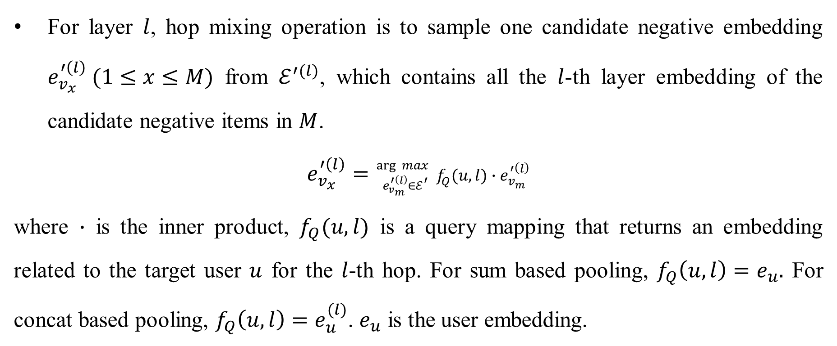
Hop Mixing
For layer $l$, hop mixing operation is to sample one candidate negative embedding $e_{v_{x}}^{′\left(l\right)} (1≤x≤M)$ from $ℰ^{′(l)}$, which contains all the $l$-th layer embedding of the candidate negative items in $M$.
$$e_{v_{x}}^{′\left(l\right)}={}_{e_{v_{m}}^{′\left(l\right)}∈ℰ^{′}}^{\arg{ max}}{ f_{Q}(u,l)∙e_{v_{m}}^{′\left(l\right)}}$$
where $∙$ is the inner product, $f_{Q}(u,l)$ is a query mapping that returns an embedding related to the target user $u$ for the $l$-th hop. For sum based pooling, $f_{Q}\left(u,l\right)=e_{u}.$ For concat based pooling, $f_{Q}\left(u,l\right)=e_{u}^{(l)}$. $e_{u}$ is the user embedding.

Slide 7
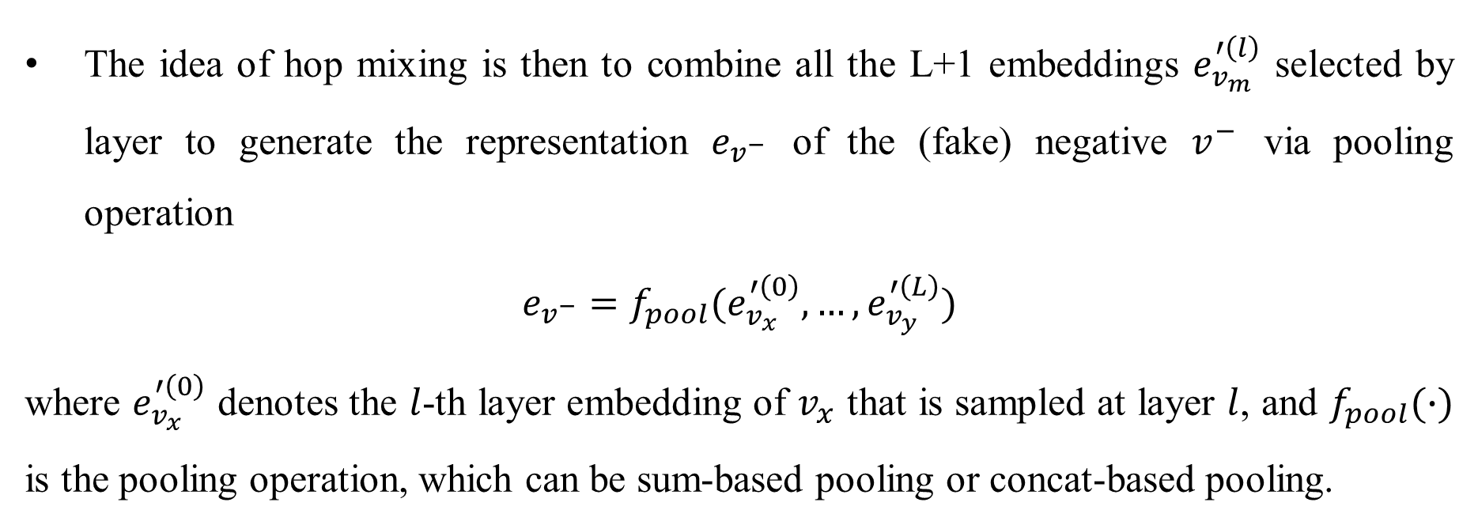
Hop Mixing
The idea of hop mixing is then to combine all the L+1 embeddings $e_{v_{m}}^{′\left(l\right)}$ selected by layer to generate the representation $e_{v^{−}}$ of the (fake) negative $v^{−}$ via pooling operation
$$e_{v^{−}}=f_{pool}(e_{v_{x}}^{′\left(0\right)},…,e_{v_{y}}^{′\left(L\right)})$$
where $e_{v_{x}}^{′\left(0\right)}$ denotes the $l$-th layer embedding of $v_{x}$ that is sampled at layer $l$, and $f_{pool}(∙)$ is the pooling operation, which can be sum-based pooling or concat-based pooling.

Slide 8
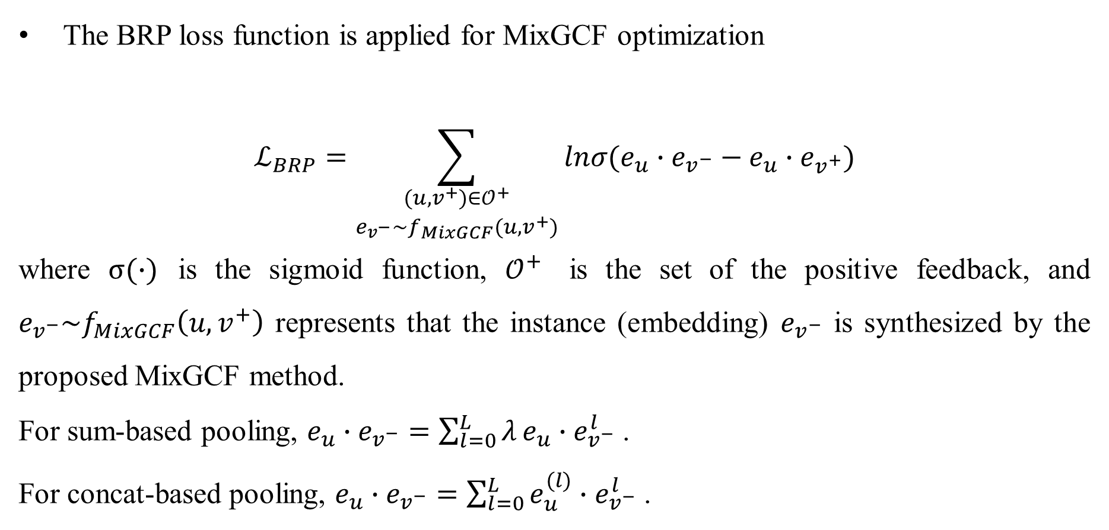
Optimization with MixGCF
The BRP loss function is applied for MixGCF optimization
$$ℒ_{BRP}=\sum_{\begin{matrix}(u,v^{+})∈𝒪^{+} \\ e_{v^{−}}\sim f_{MixGCF}(u,v^{+})\end{matrix}}{lnσ(e_{u}∙e_{v^{−}}−e_{u}∙e_{v^{+}})}$$
where $σ(∙)$ is the sigmoid function, $𝒪^{+}$ is the set of the positive feedback, and $e_{v^{−}}\sim f_{MixGCF}\left(u,v^{+}\right)$ represents that the instance (embedding) $e_{v^{−}}$ is synthesized by the proposed MixGCF method.
For sum-based pooling, $e_{u}∙e_{v^{−}}=\sum_{l=0}^{L}{λ}e_{u}∙e_{v^{−}}^{l}$ .
For concat-based pooling, $e_{u}∙e_{v^{−}}=\sum_{l=0}^{L}{e_{u}^{(l)}∙e_{v^{−}}^{l}}$ .

Slide 9
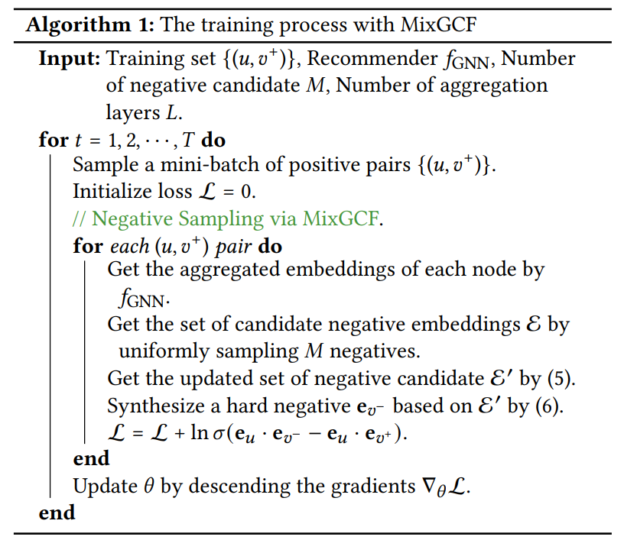
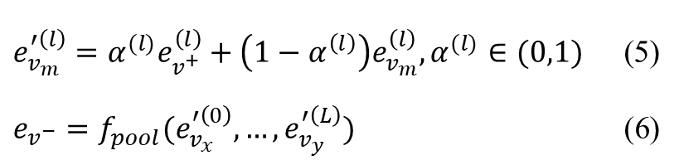
The training process with MixGCF
$e_{v_{m}}^{′\left(l\right)}=α^{(l)}e_{v^{+}}^{\left(l\right)}+\left(1−α^{\left(l\right)}\right)e_{v_{m}}^{\left(l\right)},α^{(l)}∈(0,1)$ (5)
$e_{v^{−}}=f_{pool}(e_{v_{x}}^{′\left(0\right)},…,e_{v_{y}}^{′\left(L\right)})$ (6)

Slide 10
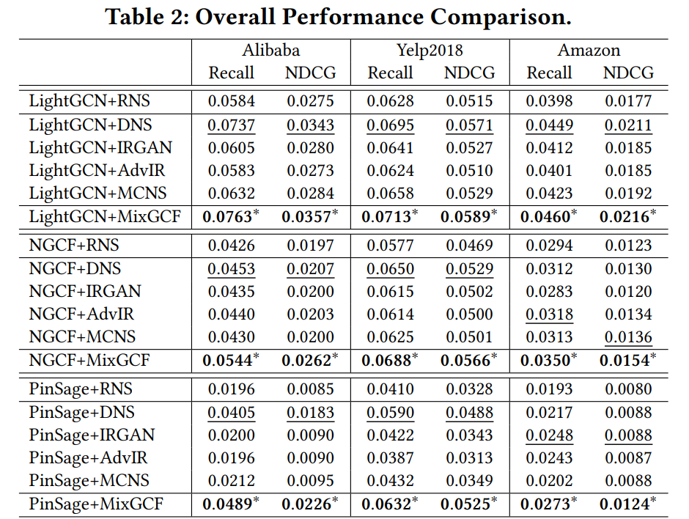
Experiments

Slide 11
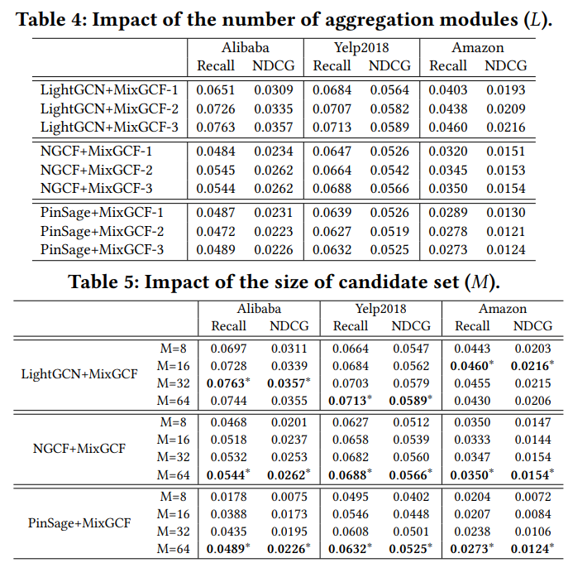
Experiments

Slide 12
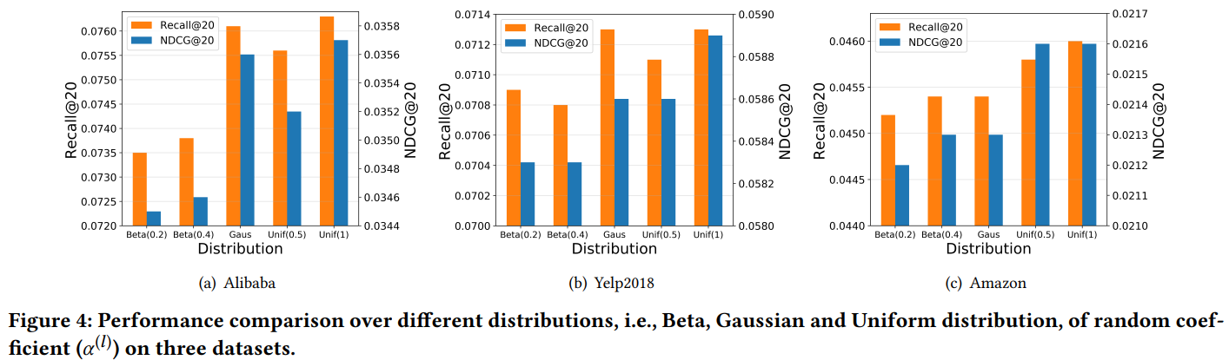
Experiments

